Slide 1
THE GREEN NEW DEAL: A HOOSIER PERSPECTIVE
Hoosier Environmental Council
all. together. now.

Slide 2
About the Hoosier Environmental Council
OUR MISSION:
The Hoosier Environmental Council is the voice of the people for the environment in Indiana-the organization with the passion and the plan to tackle our environmental challenges and help make our state a healthier, better place to live and do business.

Slide 3
The Green New Deal
What does it say?
The actual resolution (H.R. 109):
Lays out a number of scientific & economic facts
Careful forecasts with regard to climate impact
Advances strategies that should unite Americans, whatever their political worldview
Importantly DOES NOT LAY OUT SPECIFIC POLICIES BUT RATHER GOALS
Notes:
The Green New Deal (GND) is getting increasing attention in the public conversation regarding climate action. Discussion of this topic can be very hyperbolic. It is important to take the time to read the actual Congressional resolution, for which the preamble lays out a number of scientific & economic facts as well as careful forecasts with regard to climate impact. The resolution also advances strategies (e.g., modernization of buildings to maximize energy efficiency; accelerated development of zero-emission vehicles; afforestation) that should unite Americans, whatever their political worldview.

Slide 4
Green New Deal Goals:
Achieve net-zero greenhouse gas emissions through a fair and just transition for all communities and workers
Create millions of good, high-wage jobs and ensure prosperity and economic security for all people of the United States
Invest in the infrastructure and industry of the United States to sustainably meet the challenges of the 21st century
Secure for all people of the United States for generations to come: clean air and water; climate and community resiliency; healthy food; access to nature; and a sustainable environment
Promote justice and equity by stopping current, preventing future, and repairing historic oppression of indigenous peoples, communities of color, migrant communities, deindustrialized communities, depopulated rural communities, the poor, low-income workers, women, the elderly, the unhoused, people with disabilities, and youth (“frontline and vulnerable communities”)

Slide 5
In general, the GND resolution makes the case that the immense gravity and speed of climate change requires a response that is comparable in scale to this unprecedented challenge. The GND rightly alludes to past periods of American history where government and the private sector have together risen to address monumental emergencies, rightly notes that decarbonization needs to affect all sectors of the economy (and not just the electricity sector), and rightly points to the importance of paying special attention to the threats to vulnerable ecosystems and to frontline communities.
Notes:
In general, the GND resolution makes the case that the immense gravity and speed of climate change requires a response that is comparable in scale to this unprecedented challenge. The GND rightly alludes to past periods of American history where government and the private sector have together risen to address monumental emergencies, rightly notes that decarbonization needs to affect all sectors of the economy (and not just the electricity sector), and rightly points to the importance of paying special attention to the threats to vulnerable ecosystems and to frontline communities.

Slide 6
As we reflect on the GND, we believe that any ambitious climate action plan like the GND must include the following principles in its implementation:

Slide 7
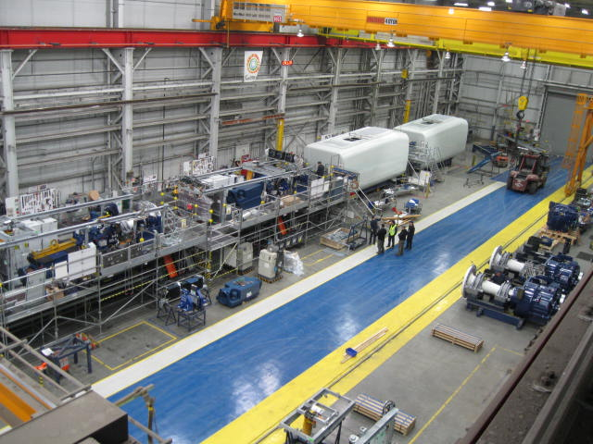
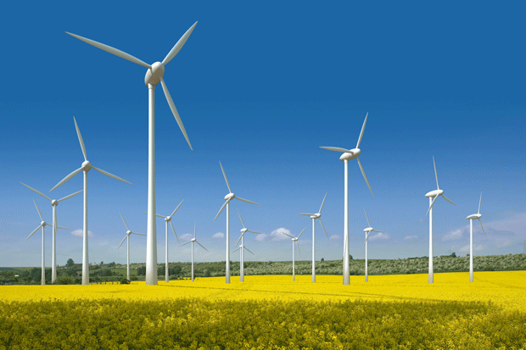
Environmentally…
We have to do everything possible to ensure that the manufacturing of renewable energy technologies (e.g., wind turbines, solar panels, utility-scale batteries) are themselves produced in a manner that is environmentally sound and protective of the safety & well-being of workers.

Slide 8
Economically…
1.) We should carefully consider the consequences of any climate action plan on the U.S. economy, including the national debt.
The Green New Deal calls for going beyond environmental policies:
Calling for a federal job guarantee, provision of health care and housing, etc.
Therefore, it will require:
Input of many experts
Must undergo a cost-benefit analysis
Notes:
We have to be mindful that implementation of any kind of ambitious climate action plan needs to consider the consequences of the plan on the U.S. economy (including the national debt), and carefully models for the immense financial costs of climate inaction. This issue particularly speaks to matters outside the traditional scope of environmental organizations (e.g., a potential federal job guarantee, federal provision of health care & housing).

Slide 9
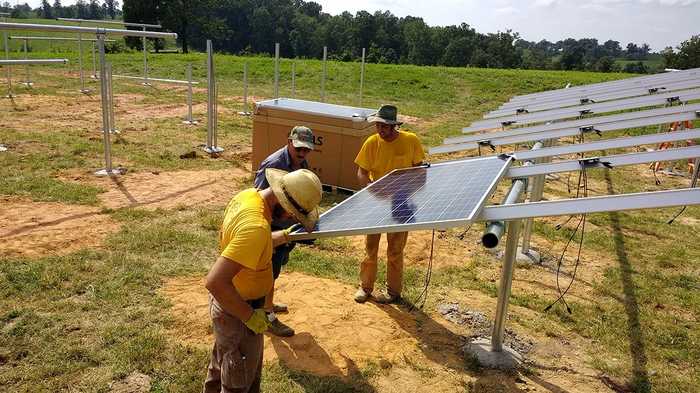
Economically…
2.) All levels of government need to create evidence-based public policy that reduces barriers to sustainable economy entrepreneurs.
These entrepreneurs have grown their businesses into successful companies and have been at the forefront of the rapid decarbonizing changes in the U.S. power and transportation sectors yet often face
obstacles.
Notes:
We need to make sure that all levels of government are creating evidence-based public policy that reduces barriers to sustainable economy entrepreneurs, particularly those in distressed rural and urban communities. These entrepreneurs have grown their businesses into successful companies and have been at the forefront of the rapid decarbonizing changes in the U.S. power and transportation sectors yet they often face obstacles posed by aging and legacy industries. We favor reducing barriers to these entrepreneurs over federal grant programs.

Slide 10
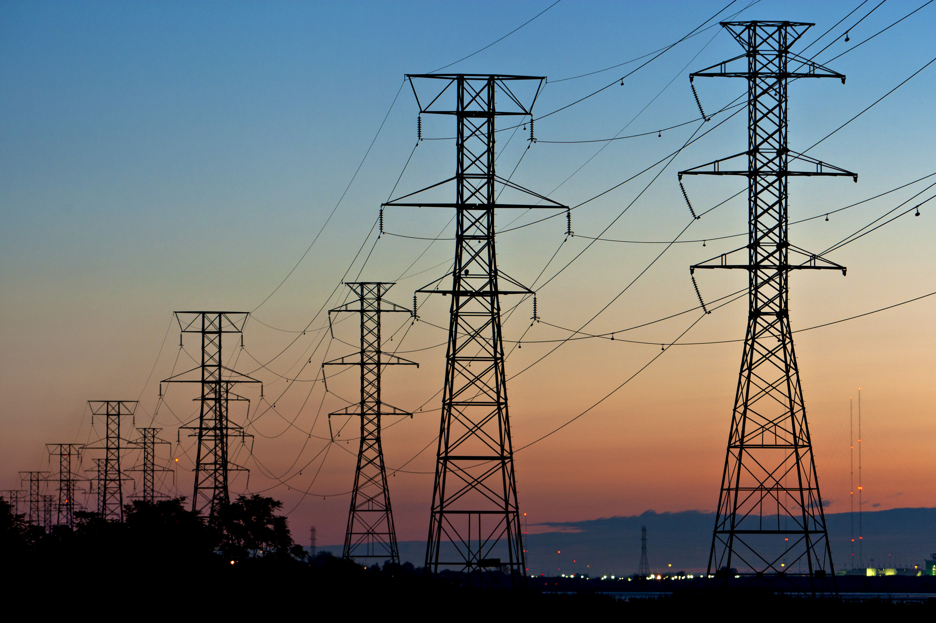
Technically…
We have to ensure that the accelerated ramp-up of renewable energy maintains high levels of reliability of our electricity grid.
To this end, HEC supports:
the reinstatement of net metering
maintaining the power of the Indiana Utility Regulatory Commission to review all proposed projects and rate changes from monopoly utilities in the state.

Slide 11
Politically…
We need to forge a plan that engages people of good faith — those sincerely interested in problem solving and bridge-building — across the political spectrum. By doing so, an ambitious climate action plan can become law, and move beyond being a discussion document.
HEC continues to work at bridge-building in communities across Indiana by engaging Hoosiers of all political persuasions to come together in looking for sound environmental policies that will improve the lives of people living in small towns like Perrysville to urban city centers like downtown Indianapolis.
We look forward to seeing people across the nation
come together to work on this most urgent of issues.

Slide 12
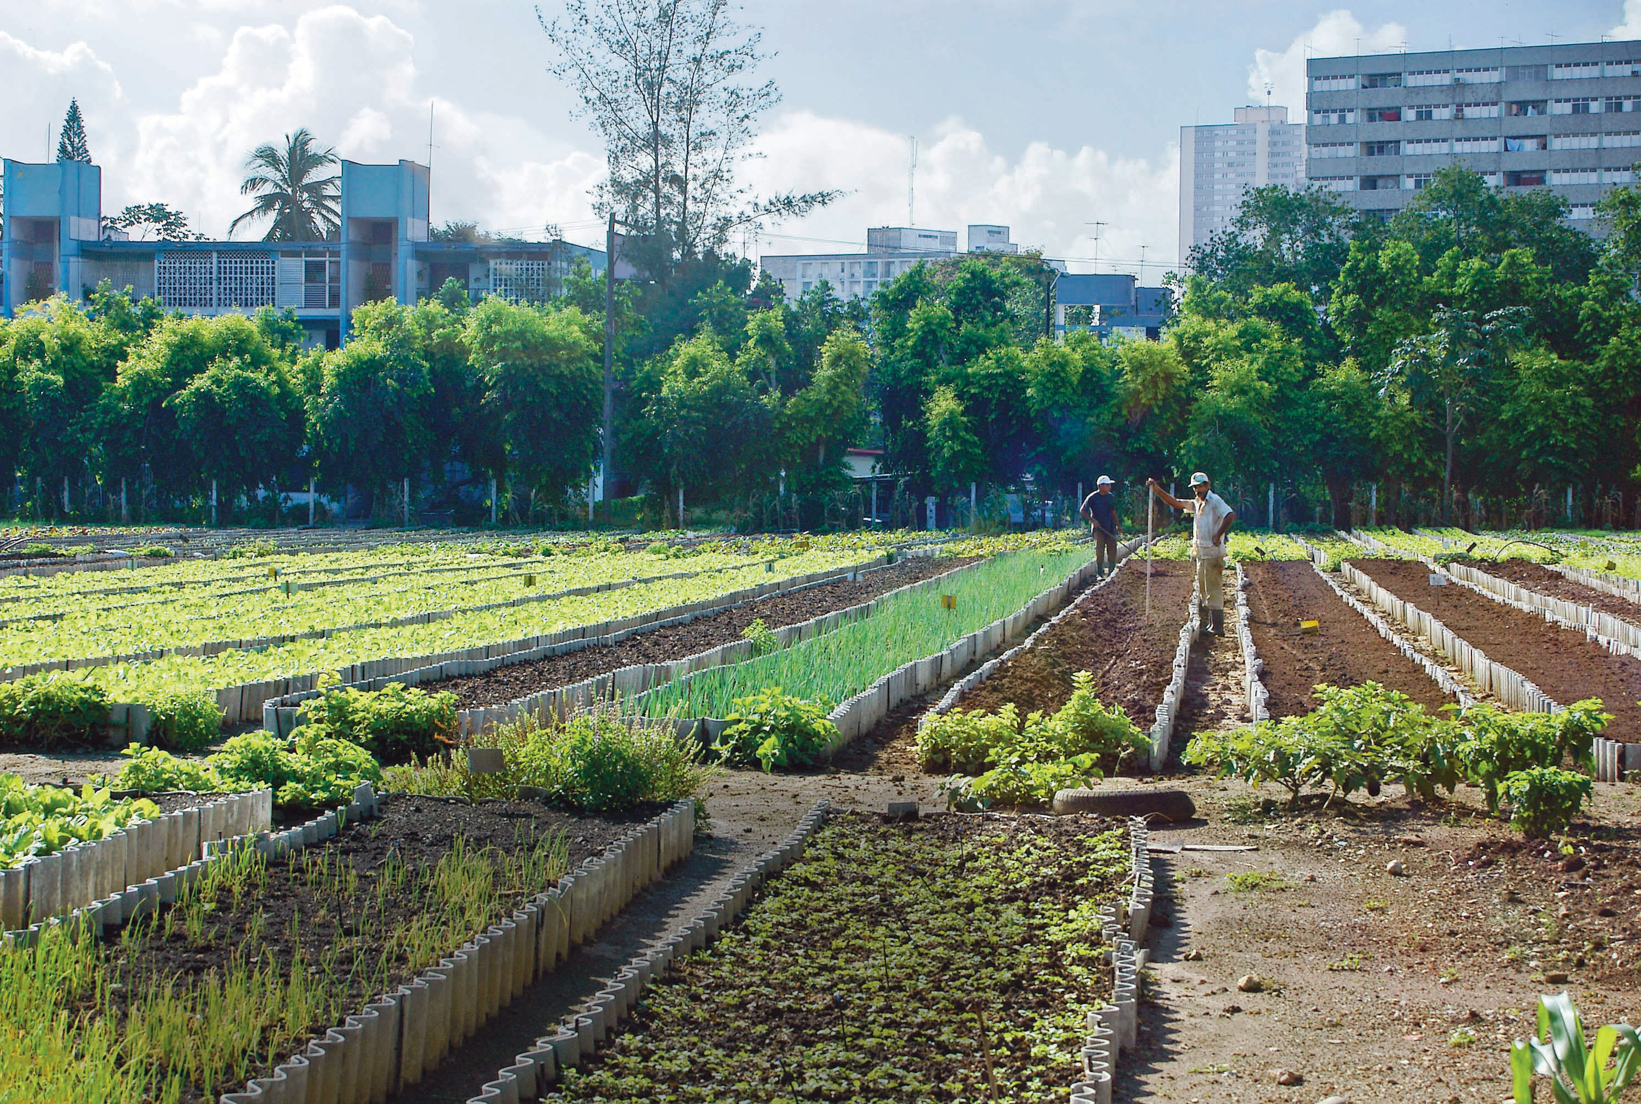
Local Dimensions of the Green New Deal
HEC is working on decarbonization efforts in:
The power sector (by advancing solar energy)
The transportation sector (by advancing mass transit & greenways)
The agriculture sector (by advancing the plant-based economy)
We are very involved in adaptation efforts through our work on stormwater management and forest protection.
We are also deeply engaged in environmental justice initiatives in historically marginalized communities in Marion County and Lake County.
Notes:
As we think about the local dimensions of the GND, note that HEC is working on decarbonization efforts in the power sector (by advancing solar energy), the transportation sector (by advancing mass transit & greenways), and the agriculture sector (by advancing the plant-based economy). We are very involved in adaptation efforts through our work on stormwater management and forest protection. Last, HEC is deeply engaged in environmental justice initiatives in historically marginalized communities in Marion County and Lake County.

Slide 13
How You Can Support Green New Deal Ideals Here in Indiana

Slide 14
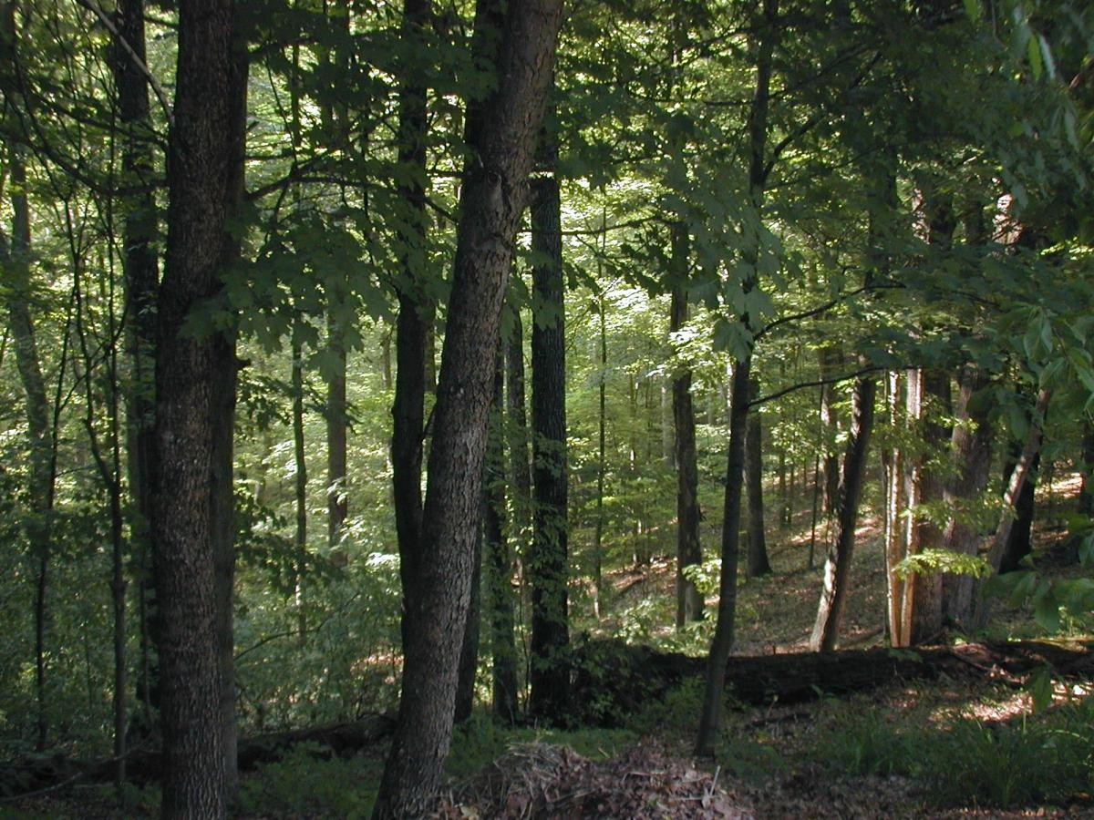
Expand Funding for Woodlands, Wetlands, & Prairies
This pertains to the once-every-two-years budget bill, “HB 1001”.
TAKE ACTION:
Ask for $10 million per year for the Benjamin Harrison Trust Fund; this fund enables our state government to forever protect endangered woodlands, wetlands, and prairies that are at risk to suburban sprawl and unchecked industrial & commercial development. (Funding for the Harrison Trust has dramatically decreased since its peak in the 1990s.)

Slide 15
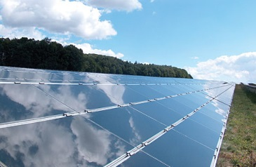
Reduce Barriers to Customer-Generated Renewable Energy
SEA 309, enacted into law in 2017, drastically and arbitrarily changes the value of solar energy on the grid; effectively penalizes transfers of ownership, solar expansions, & more. It phases out “net metering”.
Over the long run, customer-owned solar will be hurt by SEA 309.
TAKE ACTION:
Ask for support of bills like 2019’s SB 430 (which restores “net metering) and 2019’s HB 1331 (which reduces burdens on potential solar panel owners who are part of homeowner associations).

Slide 16
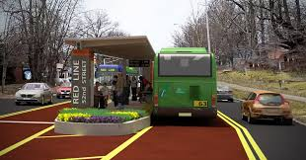
Increase Mass Transit Funding
In the 2019 legislative session, state support for mass transit funding remained flat, and state funding for the Hoosier State Passenger rail line from Indy to Chicago was eliminated.
TAKE ACTION:
Urge lawmakers to support bills like SB 285, which enables communities across Indiana to raise dedicated funds for transit.

Slide 17
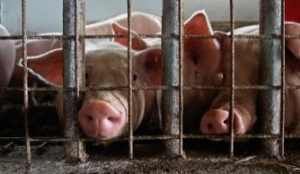
Support a Comprehensive CAFO/Factory Farm Reform Bill
A bill (HB 1378), with two 2 Repub., 2 Dem. sponsors was heard, but did not advance, in the House Env. Committee in the ‘19 session.
Would empower IDEM to deny or revoke factory farm permits for the protection of public health.
Would impose first-ever air pollution limits on factory farms.
Would establish protective setbacks between factory farms, homes, public places, and environmentally-sensitive resources.
TAKE ACTION:
Urge lawmakers to support a bill like 2019’s HB 1378.

Slide 18
Be sure to keep an eye on our Events Calendar for phone banks, future trainings, & more!
QUESTIONS?
Thank you!
My contact info:
Amanda Shepherd
ashepherd@hecweb.org

