Slide 1
Climate change primer
Jen Rowland, Ball State University
Presentation: Maring-hunt Library, Muncie, Indiana, 27 April 2019

Slide 2
Weather vs. climate
weather
climate
Short term: today, tomorrow, this week
Forecasts for a local area this week and next
Just this area
One or two plays in a single NFL game
Long term: 30+ years, decades
Patterns of averages over regions, over years
The whole atmosphere
The whole NFL season from draft picks to the Super Bowl

Slide 3
vocabulary:
Climate change: a long-term shift in the complete set of climate characteristics, caused by a net increase or decrease in atmospheric temperature.
Global warming: a net increase in atmospheric temperature.
Greenhouse gases:
Carbon dioxide
Methane
Nitrous oxide
Water vapor
Fluorinated gases
Notes:
Methane is 25 times better at trapping heat than carbon dioxide. Fluorinated gases are hundreds to thousands of times better at trapping heat.

Slide 4
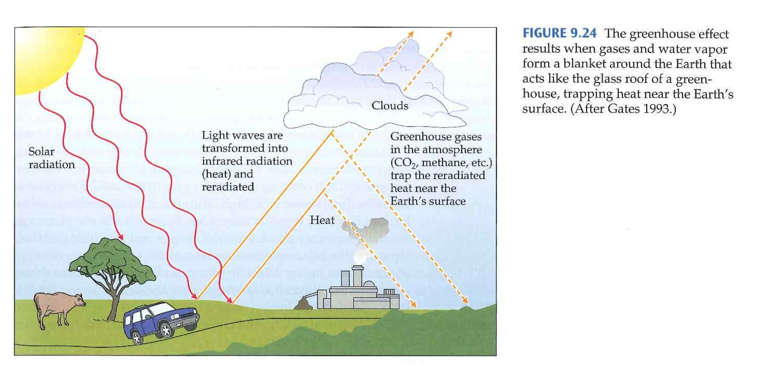
Greenhouse effect:
Source: Primack, R.B. (2010). Essentials of Conservation Biology. 5th Ed. Sunderland, MA: Sinauer.

Slide 5
What causes warming?
Ways to warm the planet:
Get more sun to the surface
Reflect less light back into space
Trap more heat (greenhouse gases)
Different patterns of warming for each:
Warming from greenhouse gases matches the current pattern of warming
Carbon dioxide from burning fossil fuels has caused the majority of the recent increase in greenhouse gases

Slide 6
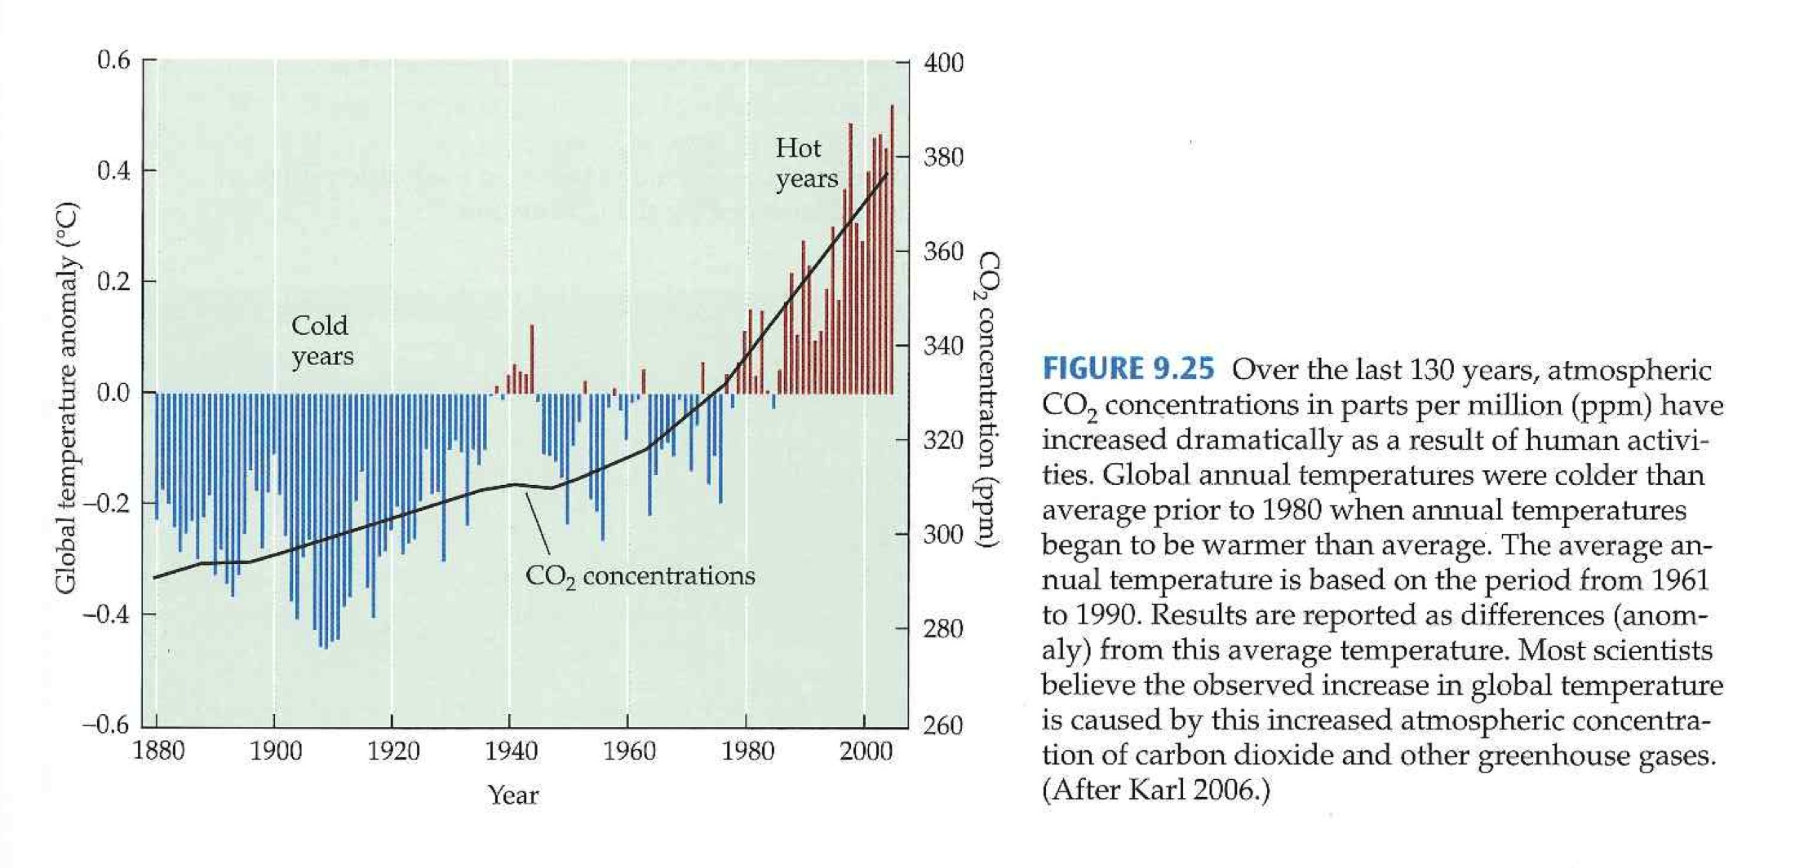
Source: Primack, R.B. (2010). Essentials of Conservation Biology. 5th Ed. Sunderland, MA: Sinauer.

Slide 7
Hasn’t the climate always been Changing?
Yes, the climate has changed naturally in the past! But that just tells us the climate can change naturally, not that the climate is changing naturally now.
There have been periods of cooling and warming.
BUT: any time warming has risen, it’s taken thousands of years. We’ve warmed at an unprecedented rate.
What took thousands of years in the past has taken us just since the 1950s.
And the causes are different: this is caused by a massive release of carbon dioxide from burning fossil fuels.

Slide 8
Evidence of climate Change:
Increased temperatures overall; increased incidence of extreme conditions
18 of the 19 hottest years on record have occurred since 2001
Ex: Storm intensity has increased since 80s, desertification
Melting of glaciers and polar ice: Arctic projected to be ice-free in the summers by mid-century Rising sea levels: 8 inches in the last century, but double that speed in the last 2 decades!
Increase in ocean acidity: increase of 30% since Industrial Revolution
Earlier flowering of plants
Earlier spring activity
Shift in species ranges
Population declines & extinctions
Notes:
Citations and sources at end of presentation

Slide 9
Targets:
No more than 1.5°C by 2100 (IPCC target)
For a 50/50 shot at meeting a goal of 1.5°C by 2100:
Emissions net-zero by 2050
And negative emissions beyond that point
For better than a 50/50 shot:
Cut emissions 50-65% by 2030
See: IPCC Special Report https://www.ipcc.ch/sr15/

Slide 10
Where we are:
1°C over pre-industrial era
On the course of proposed action under the Paris Agreement, warming will reach 2.6 - 3.1°C by 2100 (assuming best-case scenario and everyone reaching their goals in record time).
Energy growth is 2% a year. We need growth to drop by 6% a year.
See: Rogelj, J., et al.(2016). Paris Agreement climate proposals need a boost to keep warming well below 2 °C. Nature, 534(7609), 631-639. doi:10.1038/nature18307 and Blanco, G. et al. (2014). Drivers, Trends and Mitigation http://pure.iiasa.ac.at/id/eprint/11120/1/ipcc_wg3_ar5_chapter5.pdf

Slide 11
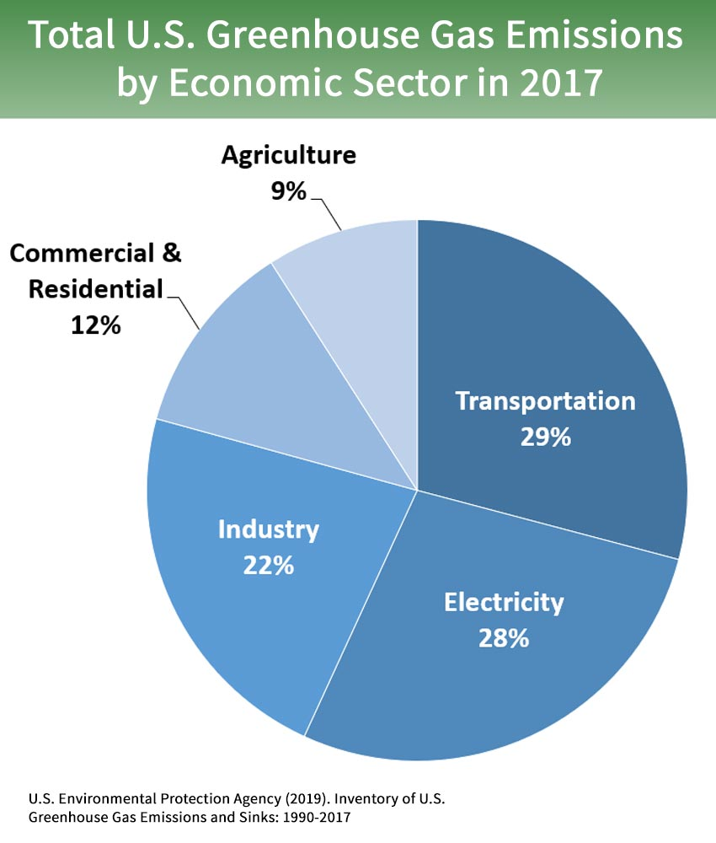
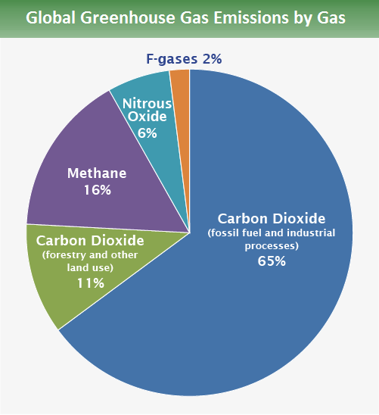
Types & Sources of emissions:
U.S. Environmental Protection Agency, from IPCC 2014 and
US EPA Inventory of US Greenhouse Gas Emissions and Sinks
Notes:
IPCC 2014: https://www.ipcc.ch/report/ar5/wg3/
EPA Inventory: https://www.epa.gov/ghgemissions/inventory-us-greenhouse-gas-emissions-and-sinks

Slide 12
Citations and Sources:
Allstadt, A. J., Vavrus, S. J., Heglund, P. J., Pidgeon, A. M., Thogmartin, W. E., & Radeloff, V. C. (2015). Spring plant phenology and false springs in the conterminous US during the 21st century. Environmental Research Letters, 10(10), 104008. doi:10.1088/1748-9326/10/10/104008. Available at http://climatechange.lta.org/early-spring-impacts/
Blanco G., et al. 2014: Drivers, Trends and Mitigation. In: Climate Change 2014: Mitigation of Climate Change. Contribution of Working Group III to the Fifth Assessment Report of the Intergovernmental Panel on Climate Change [Edenhofer, O., et al. (eds.)]. Cambridge University Press, Cambridge, United Kingdom and New York, NY, USA. Available at https://www.ipcc.ch/site/assets/uploads/2018/02/ipcc_wg3_ar5_chapter5.pdf
Chen, I., Hill, J. K., Ohlemuller, R., Roy, D. B., & Thomas, C. D. (2011). Rapid range shifts of species associated with high levels of climate warming. Science, 333(6045), 1024-1026. doi:10.1126/science.1206432
Chivian, E., & Bernstein, A. (2008). Sustaining life: How human health depends on biodiversity. Oxford: Oxford University Press. Summary and report available at https://www.bu.edu/sph/files/2012/12/Chivian_and_Bernstein_2010_How_our_Health_Depends_on_Biodiversity.pdf
Ellwood, E. R., Temple, S. A., Primack, R. B., Bradley, N. L., & Davis, C. C. (2013). Record-breaking early flowering in the eastern United States. PLoS ONE, 8(1). doi:10.1371/journal.pone.0053788. Available at https://journals.plos.org/plosone/article?id=10.1371/journal.pone.0053788
Herold, N., Huber, M., & Müller, R. D. (2011). Modeling the Miocene climatic optimum. Part I: Land and atmosphere. Journal of Climate, 24(24), 6353-6372. doi:10.1175/2011jcli4035.1. Available at https://journals.ametsoc.org/doi/full/10.1175/2011JCLI4035.1
IPCC, 2018: Summary for Policymakers. In: Global Warming of 1.5°C. An IPCC Special Report on the impacts of global warming of 1.5°C above pre-industrial levels and related global greenhouse gas emission pathways, in the context of strengthening the global response to the threat of climate change, sustainable development, and efforts to eradicate poverty [Masson-Delmotte, V., et al. (eds.)]. World Meteorological Organization, Geneva, Switzerland, 32 pp. Available at https://www.ipcc.ch/sr15/
Lüthi, D., Floch, M. L., Bereiter, B., Blunier, T., Barnola, J., Siegenthaler, U., . . . Stocker, T. F. (2008). High-resolution carbon dioxide concentration record 650,000–800,000 years before present. Nature, 453(7193), 379-382. doi:10.1038/nature06949. Available at https://epic.awi.de/id/eprint/18281/1/Lth2008a.pdf
McInerney, F. A., & Wing, S. L. (2011). The Paleocene-Eocene thermal maximum: A perturbation of carbon cycle, climate, and biosphere with implications for the future. Annual Review of Earth and Planetary Sciences, 39(1), 489-516. doi:10.1146/annurev-earth-040610-133431

Slide 13
Citations and Sources (continued)
NASA/GISS. (2019, April 24). Global Surface Temperature. https://climate.nasa.gov/vital-signs/global-temperature/
NOAA Pacific Marine Environmental Laboratory Carbon Group. (n.d.). A primer on pH. https://www.pmel.noaa.gov/co2/story/A primer on pH
Primack, R.B. (2010). Essentials of Conservation Biology. 5th Ed. Sunderland, MA: Sinauer
Rogelj, J., et al.(2016). Paris Agreement climate proposals need a boost to keep warming well below 2 °C. Nature, 534(7609), 631-639. doi:10.1038/nature18307 and Blanco, G. et al. (2014). Drivers, Trends and Mitigation http://pure.iiasa.ac.at/id/eprint/11120/1/ipcc_wg3_ar5_chapter5.pdf
Screen, J. A., & Deser, C. (2019). Pacific ocean variability influences the time of emergence of a seasonally ice‐free Arctic Ocean. Geophysical Research Letters, 46(4), 2222-2231. doi:10.1029/2018gl081393. Available at http://www.cgd.ucar.edu/staff/cdeser/docs/screen.toe_ice-free_arctic.grl19.pdf
US Environmental Protection Agency. Inventory of U.S. Greenhouse Gas Emissions and Sinks (1990-2017). (2019, April 11). Overview at https://www.epa.gov/ghgemissions/inventory-us-greenhouse-gas-emissions-and-sinks Full Report at https://www.epa.gov/ghgemissions/inventory-us-greenhouse-gas-emissions-and-sinks-1990-2017
Viñas, M., & Rasmussen, C. (2015, August 25). Warming seas, melting ice sheets (R. Garner, Ed.). https://www.nasa.gov/feature/goddard/warming-seas-and-melting-ice-sheets
Walther, G., Post, E., Convey, P., Menzel, A., Parmesan, C., Beebee, T. J., . . . Bairlein, F. (2002). Ecological responses to recent climate change. Nature, 416(6879), 389-395. doi:10.1038/416389a

